Slide 1
Human–Computer Interaction
Evaluation in practice
Ann Blandford

Slide 2
Aims of this session
You should be able to design and run a think-aloud study
  Including task design
You should be aware of tools that exist for logging and to support analysis

Slide 3
Think-aloud protocols
Usually pre-define tasks for users (if in lab)
  More common to let users define their own tasks if done in naturalistic setting
Instruct users on what to talk about while working
Remember that think-aloud may interfere with task progress, so use with care

Slide 4
Think aloud considerations
If what you’re interested in is interface design then think-aloud should not interfere
If you’re interested in cognition / problem solving then the general consensus is that think-aloud doesn’t interfere provided that…
  The participant has practice in thinking aloud
  The participant is only talking to themselves, and not explaining thing to the experimenter
Think-aloud doesn’t work well for understanding activities that themselves involve verbal activity

Slide 5
Think-aloud practice
Recording may include:
  Screen capture & user action logging
  Audio of speech
  Video of screen, face, hands (with audio)
Transcribing (for audio / video) may be complete or selective
Analysis generally involves coding for particular event types – e.g. errors, uncertainties, design suggestions

Slide 6
Designing tasks
If the study is naturalistic then you don’t need to define tasks
  though you might want to know what people are aiming to do.
You need to consider:
  Specificity of task (how much freedom of choice do you want participants to have)
    E.g. “choose a kind of present then find the cheapest supplier of it” vs. “find the cheapest supplier of perfume X”
  Domain or device tasks
    E.g. “you are looking for a present for a friend” vs. “click on the X link then browse the page to find the price of product Z”
  How much detail you give about how to complete task
    E.g. if you are testing the ‘search’ functionality of an e-commerce site you, might tell participants to use search rather than browse

Slide 7
Designing instructions
Need to explain how to “think aloud”
Need to describe activities in a form that makes sense to participants
Sometimes, create a scenario to add realism (of a kind!) to tasks
  Scenario must be one with which participants can identify

Slide 8
Example instructions
“I’m testing how people buy household gifts on the Amazon website. Imagine that good friends are having a house warming party and you wish to buy a small present (about £10). Think of friends that might hold such a party. Go to Amazon and find a suitable gift for them. Think aloud while you’re looking. For example: How are you choosing where to look? How easy is it to find the next action? What effect do you expect that action to have? Are you getting closer to your goal? Stop when you’ve found something suitable for your friends. Thank you for taking part in this study.”

Slide 9
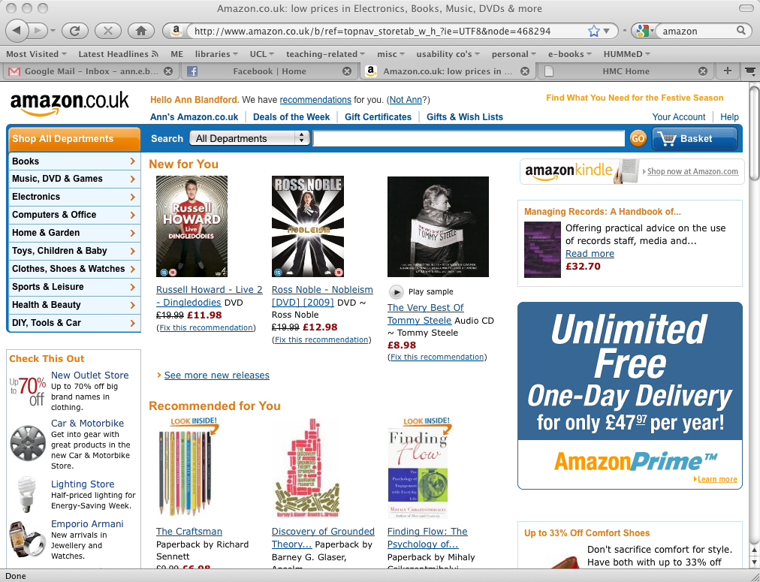
Brief example TA
Notes:
Talk around display. Choose search (why?)

Slide 10
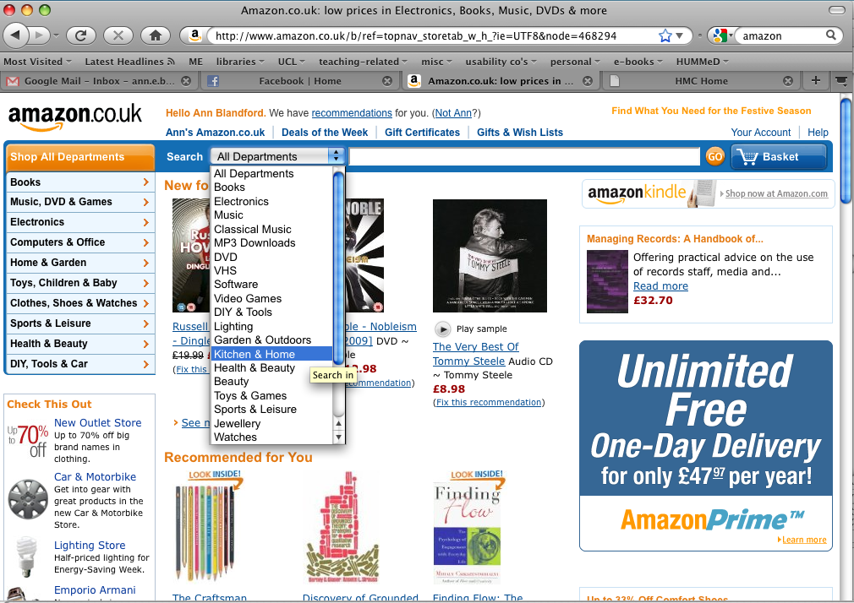
Notes:
Why focus on particular departments?

Slide 11
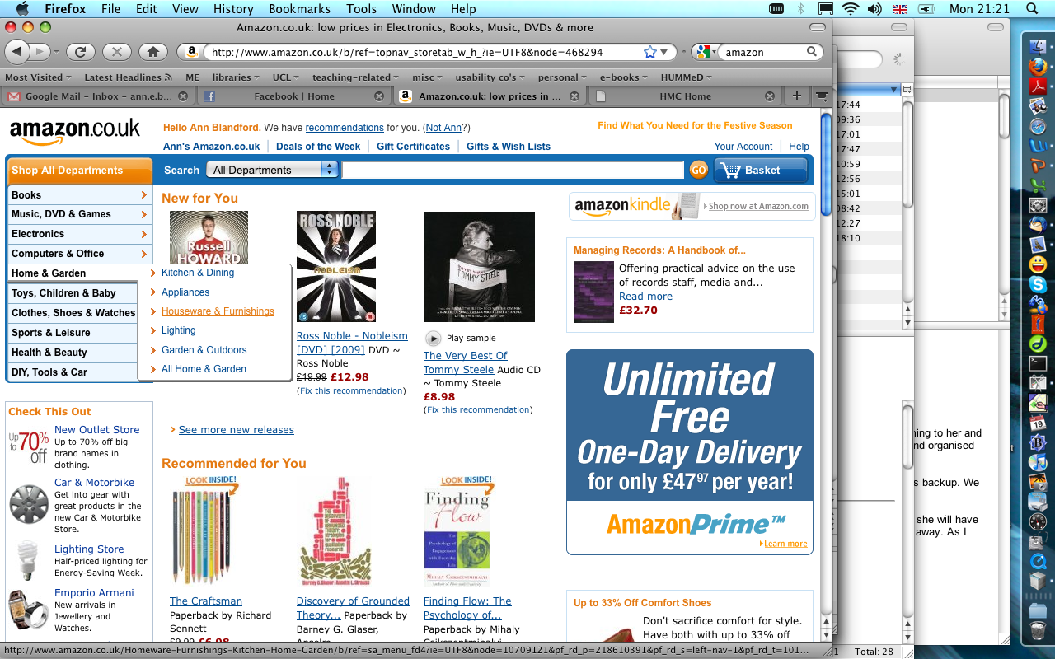
Notes:
Compare browse options with search ones

Slide 12
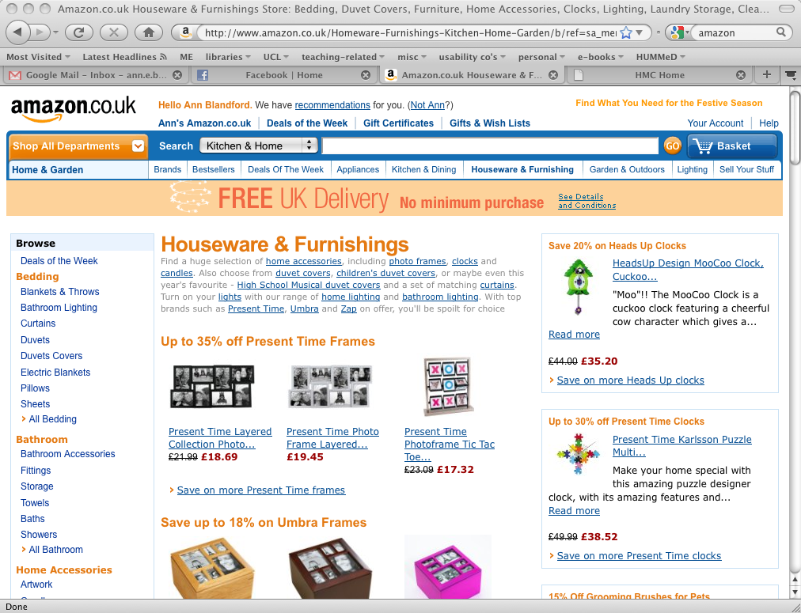
Notes:
How promising does this look? Scroll down…

Slide 13
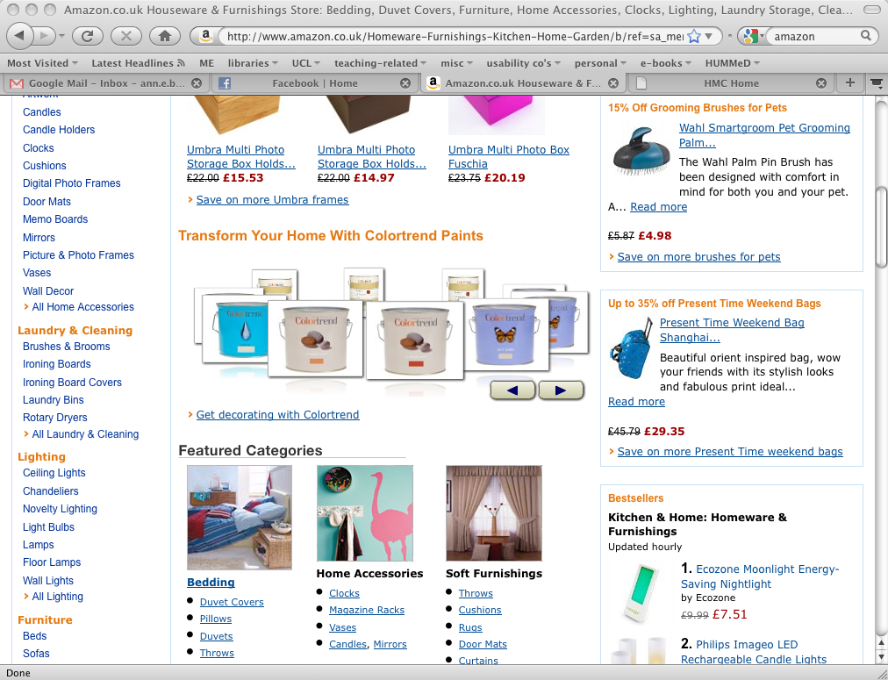
Notes:
…and again.

Slide 14
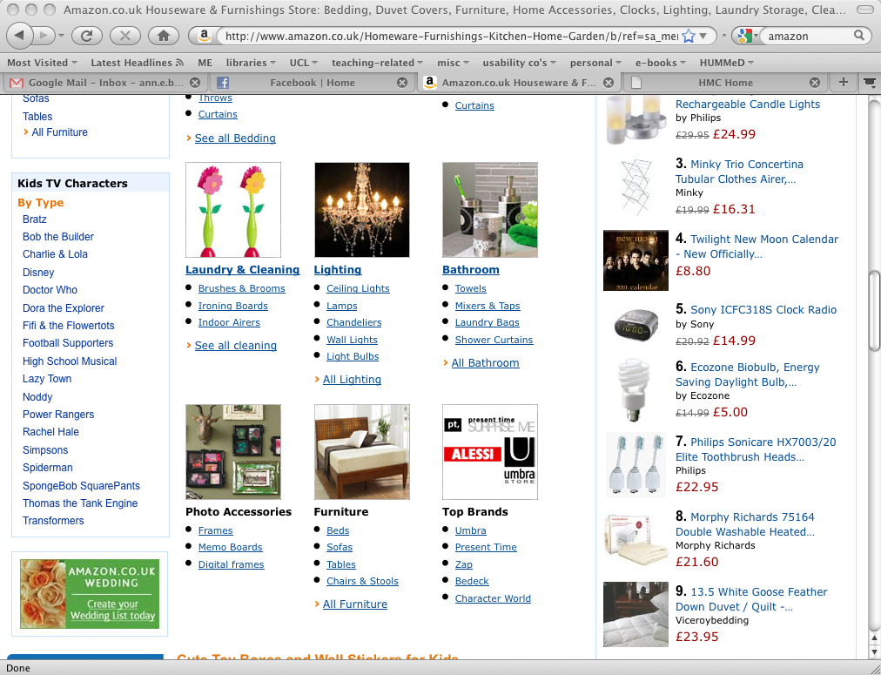

Slide 15
Tools for data capture and analysis
There are several tools available for capturing a video of the screen while users are interacting
  E.g. TechSmith’s Camtasia (http://www.techsmith.com/)
    You might like to watch the Morae video:
    http://www.techsmith.com/morae/webdemo.asp
  E.g. Adobe Captivate; Balesio TurboDemo, Matchware Screencorder (http://www.matchware.com/en/products/screencorder/default.htm) etc.
There are also tools for editing and analysing video data
  E.g. Noldus Observer
We don’t use these tools in the course, but they may be relevant to you later…

Slide 16
A note on usability labs
Commercial usability consultancies generally have usability labs for conducting studies and showing them to clients.
Main study type: think-aloud protocol on pre-determined tasks
Secondary type: controlled comparative experiments

Slide 17
Triangulation
Use methods in complementary ways to build up rich understanding of the situation / design / requirements.
Methods should complement each other.
If there are apparent conflicts, that merits further investigation.

Slide 18
Usual caveats
This list of techniques is far from complete.
Any technique or methodology (i.e. structured set of techniques) has to be adapted to fit the context of use and the needs of the data gathering.

Slide 19
What makes a good (i.e. effective) task scenario?
Ecological validity
Precise enough to test the features you want to test
Loose enough to gather realistic user behaviour
Clear enough for participants to understand

Slide 20
Summary
There are a range of techniques…
  Demanding more or less skill of the analyst
  Requiring access to users or not
  Applicable at different stages in design
  Yielding different kinds of insights about usability of systems
  You often need to mix, match and adapt, depending on what you’re evaluating and what resources you have available

Slide 21
Some reading highlights
Interaction Design (2nd Ed) Chapter 7.
Nielsen, J., Clemmensen, T., and Yssing, C. 2002. Getting access to what goes on in people's heads?: reflections on the think-aloud technique. In Proc. Second Nordic Conference on Human-Computer Interaction. NordiCHI '02, vol. 31. ACM, New York, NY, 101-110.

Slide 22
Brief review
This part of COMP2009 has been a very quick tour through…
  Techniques for gathering and representing user requirements
  User-centred design representations
  Methods for evaluating interactive systems
“If the user can’t use it, it doesn’t work”
    (Susan Dray)

Slide 23
Times change, and design challenges change
Design issues have changed since the days of the Manchester Baby. How?
How will this affect your future practices?

Slide 24
Questions or comments?
Thank you for your attention. I hope you’ve enjoyed this part of the course – or at least found it interesting and useful.
Ann Blandford

